Slide 1



DataCo Smart Supply Chain Data Analysis
DataCo
Team Members: 1. Fayiq Ahmed K
2. Supriyo Dey
3. Sai Charan
4. Akhil Raj
5. Bharath S
Mentored By:
Mr. Animesh Tiwari

Slide 2
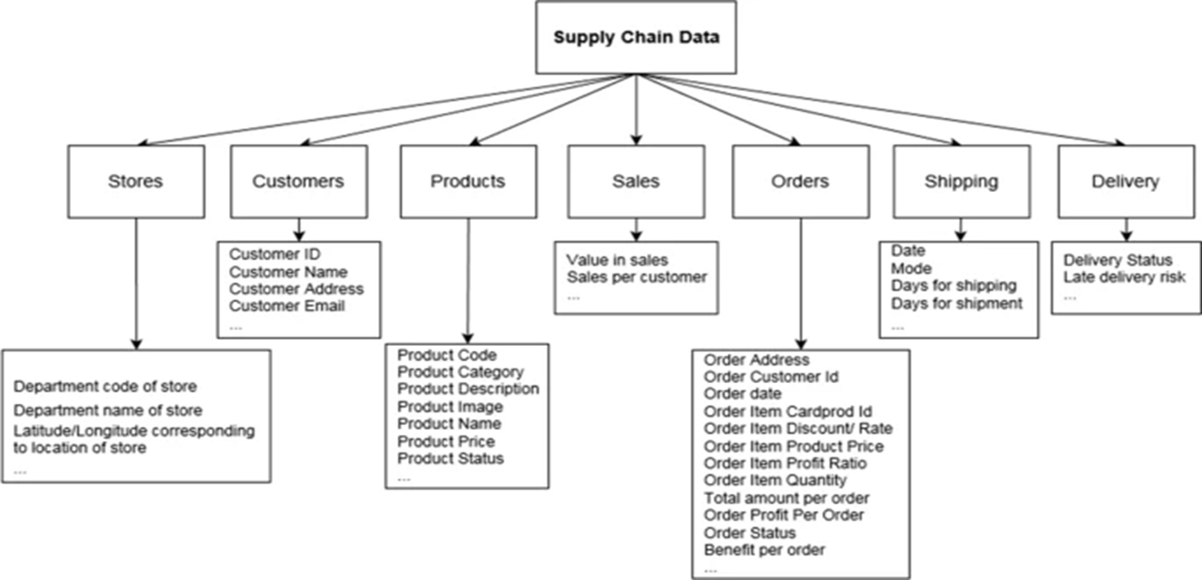

Problem Definition and Importance
Mapping out a supply chain is one of the critical steps in performing an external analysis in a strategic planning process. The importance of clearly laying out the supply chain is that it helps a company define its own market and decide where it wants to be in.
Detection of high risk (fraudulent) product category, products, transaction modes along with demographic characteristics and personal attributes of customer who are susceptible or contributing towards fraudulent activities.
Customer Segmentation through RFM Analysis.

Slide 3
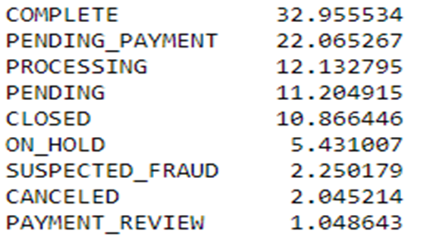
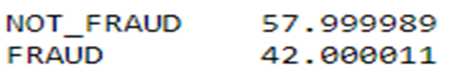
Data Preprocessing & Cleaning
Variable categorization :
No. of Numerical Columns: 29
No. of Categorical Columns: 24
The DataCo dataset dimension = 180519 rows & 53 columns.
Null Value Imputation :
Customer Lname 0.004432
Customer Zip code 0.001662
Order Zip code 86.239676
Product Description 100.000000
These were the columns having Null values. The two columns Order Zip code and Product Description both have highest null values, for the given objectives the zip code is not required and also the Description is also not required, so dropped the two columns.
Target Column Division :
The Categories COMPLETE, PROCESSING, CLOSED, CANCELED can be categorized as NON-FRAUD as the order is processed or in processing state. The Categories PENDING_PAYMENT,PENDING, ON_HOLD, SUSPECTED-FRAUD, PAYMENT_REVIEW can be categorized as FRAUD as the order is on hold, or on review.

Slide 4
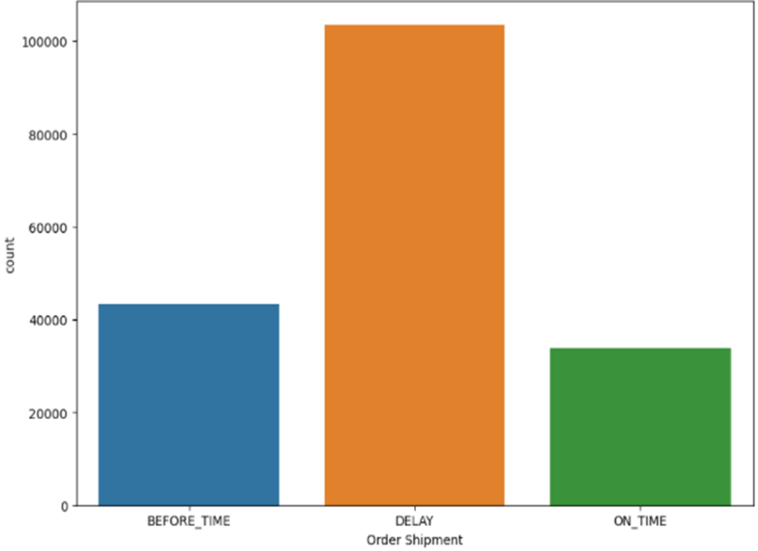
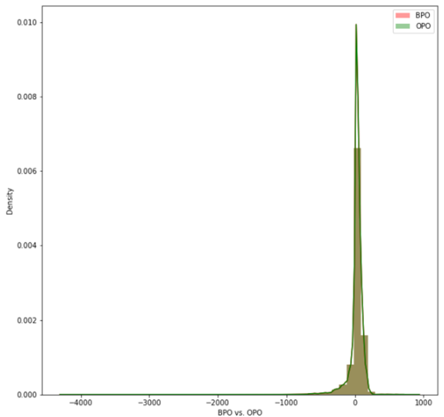
Exploratory Data Analysis
Days for shipping(real) and Days for shipping(scheduled) are telling the number of days it took to deliver the order, created 1 column telling if the order shipment was delayed, on-time or before-time
Dropped the column Late delivery risk, as we will not calculate the time for delivery
From the categorical columns customer email and password were removed as both were having hidden characters, customer Fname and Lname also can be removed as customer ID is present, Product Image can be removed as it is a hyper link which is not useful, shipping data was removed as we already have created a new column telling us if the shipment is delayed or not.
From the numerical columns Benefit per order and Order Profit Per Order are both the same.
Product Status has only one value 0 in the whole column. So, dropped it.

Slide 5
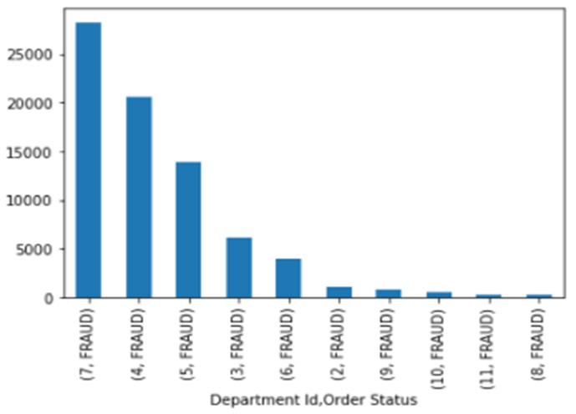
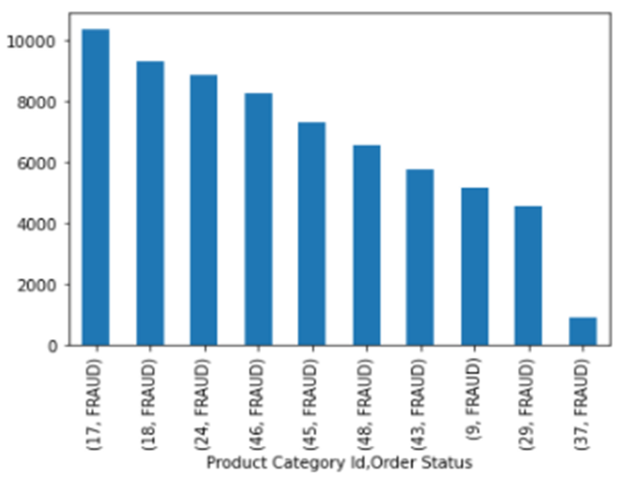
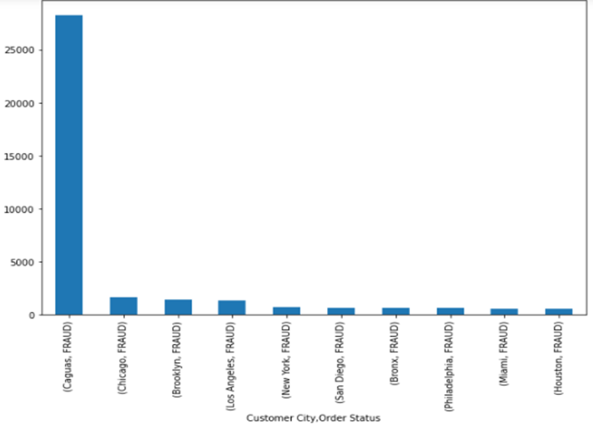
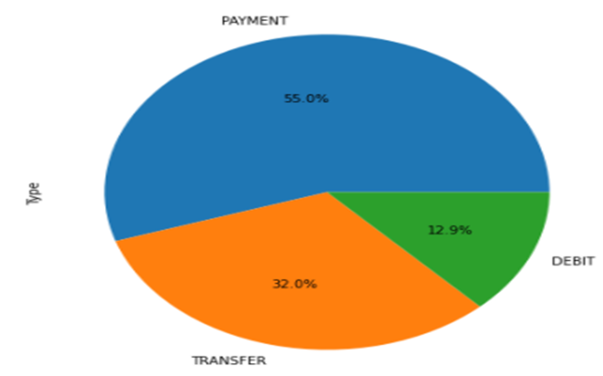
Exploratory Data Analysis……

Slide 6
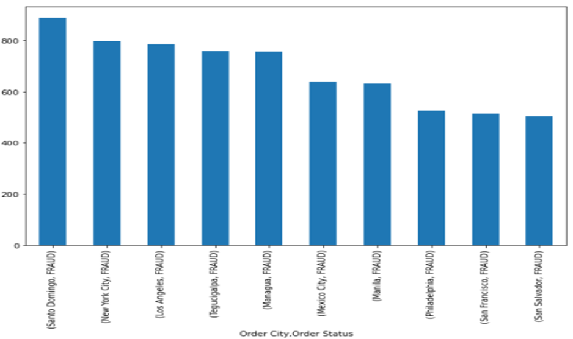
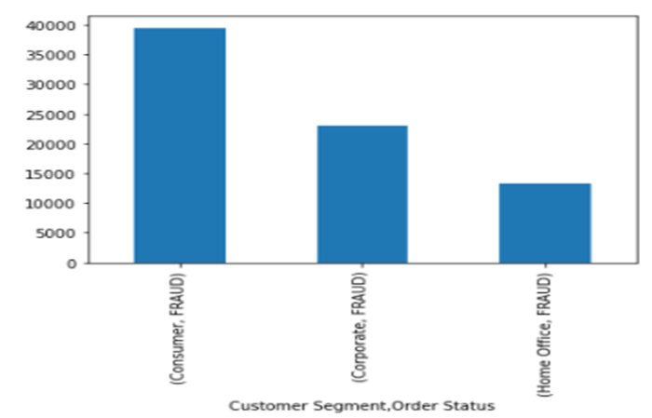
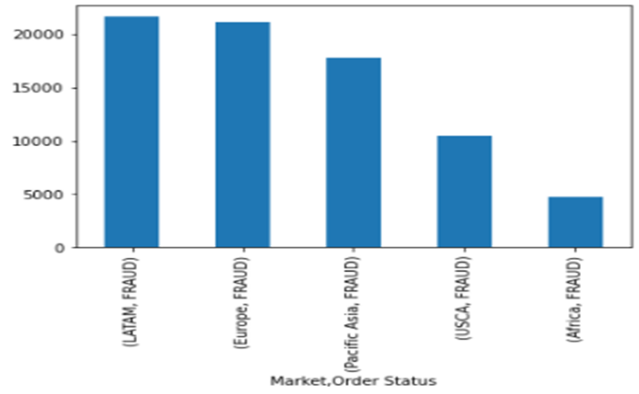
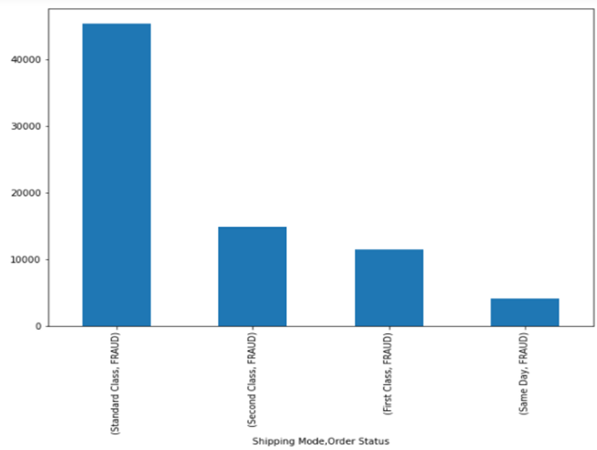
Exploratory Data Analysis……

Slide 7
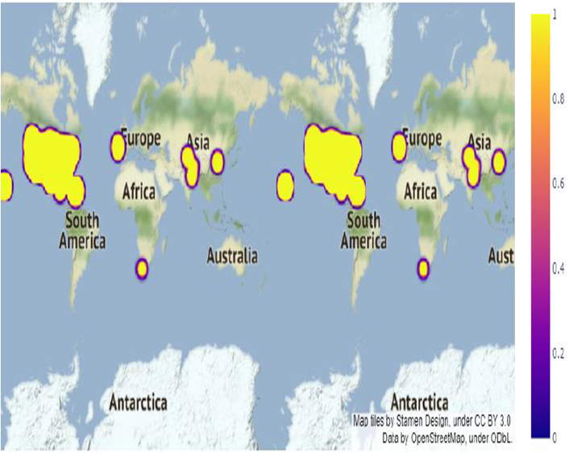
Exploratory Data Analysis……
Top 10 customer id's who are fraudulent customer, product id's which a fraudulent person will try to fraud.
Top 10 categories which a fraudulent person will try to commit fraud, cities where fraudulent orders are placed from.
Fraudulent customers are located by using the Longitude and Latitude.
Different market regions where fraudulent activities happen.
Top 10 Number of fraudulent activities for each year, each month in the dataset.
Trend in fraudulent activity for each month, max fraudulent activity happens in January and July.
If Fraudsters orders something, they tend to go with Standard Class of shipping
Department 7 has number of fraudulent customers

Slide 8
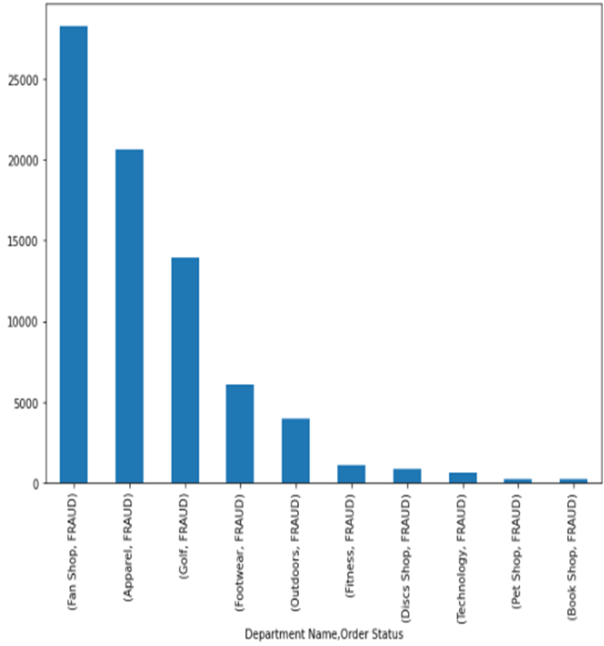
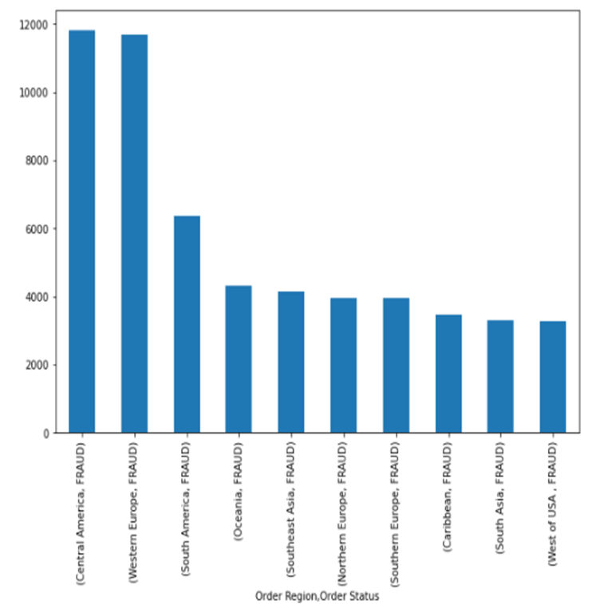
Exploratory Data Analysis……
Fraudsters have no specific day to place fraud orders.
Top 10 order regions where fraudulent activities happens the most.
Top 10 Department names which have high fraudulent orders.
Top 10 Product names that fraudsters tries to buy.

Slide 9
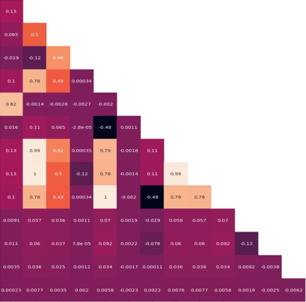
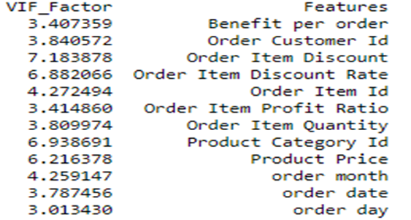
Outliers Check and Multicollinearity
Checked the presence of outliers by using the IQR technique.
(% of outliers in the dataset features) :
% of loss of data : 17.40
Since the percentage of removal is very
high we will not be removing the outliers
from the original dataset as
data loss is very high.
We used for loop to find VIF and removed
the variables with VIF greater than 10.
We set the threshold to 10, as we wish to
remove the variable for which the remaining
variables explains more than 90% of the
variation. One can choose the threshold
Other than 10.
(It depends on the business requirements)
After removal of features >>>>>>

Slide 10
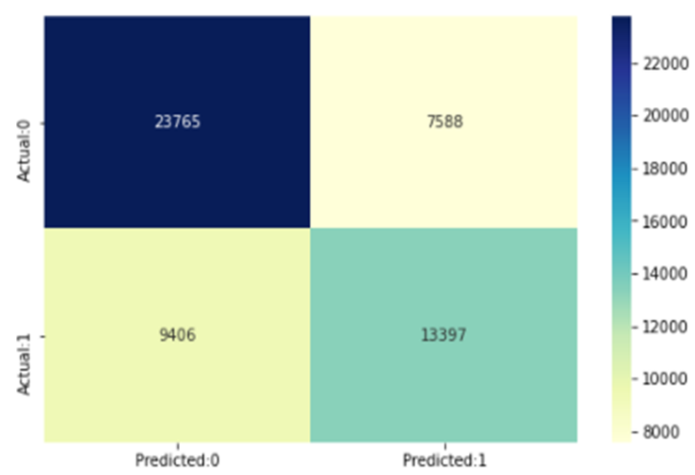
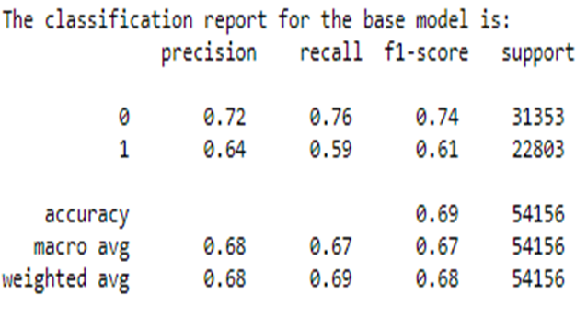
Base Model & Assumptions
Assumption 1: The target variable i.e., Order Status is a categorical variable.
Assumption 2: No / less multicollinearity among features.
Through VIF we have removed the multicollinearity from all the numeric columns of the dataset and verified the same by Heatmap.
We have used Power Transformation for scaling skewness of the features.
Due to large no. of Unique Categories in some categorical columns, rather than going with One hot Encoding, we used Label Encoder for intact dimension during Modelling.
After going through the P>|z| of base Logit Model summary, we have taken the insignificant features having p>0.05. Eliminated those through Backward Elimination Technique.
Accuracy = 0.6862028214786912
Sensitivity = 0.5875104152962329
Specificity = 0.7579816923420406
Miss-classification = 0.31379717852130884

Slide 11
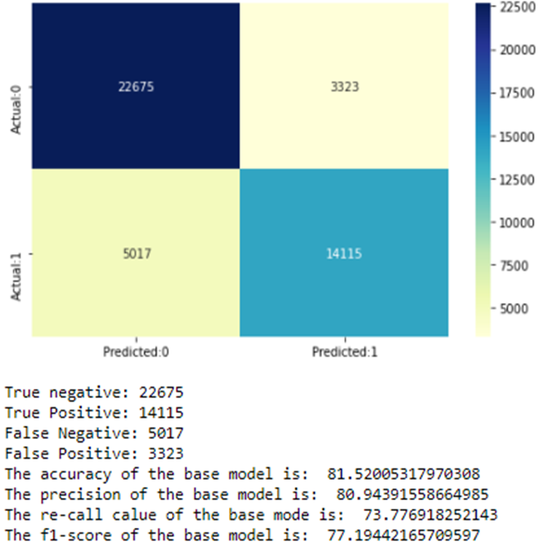
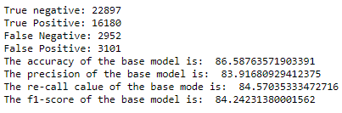
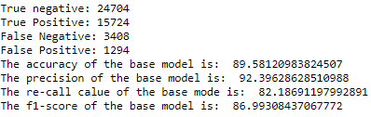
Modelling with Advanced Algorithms
Class Imbalance Check ---- Decision whether to use Resampling Technique like SMOTE.
0 57.999989 *** There is no presence of Class Imbalance.
42.000011
Implementing KNN Implementing Decision Tree
Implementing Random Forest

Slide 12
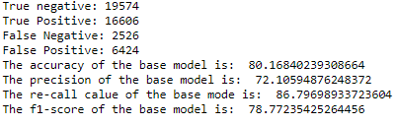
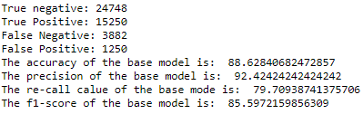
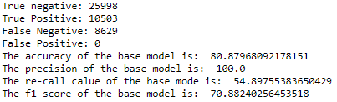
Modelling with Advanced Algorithms
Implementing Naïve Bayes Implementing Bagging Classifier
Implementing AdaBoost

Slide 13
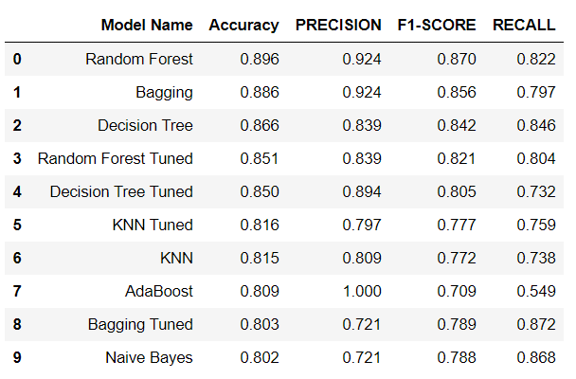
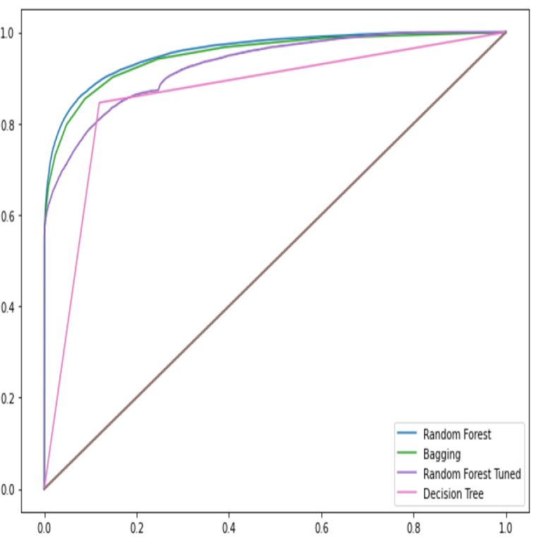
Modelling with Advanced Algorithms
Results after Performing Hyperparameter Tuning on the Algorithms applied upon Base Model:
The above ROC_AUC Curve shows the top 4 performing algorithms on our objectives.
From the above table and the results that we have achieved here, we see that RANDOM FOREST will give us the best accuracy to detect a FRAUD activity.

Slide 14
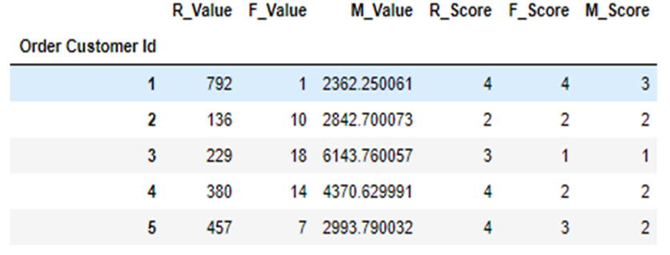
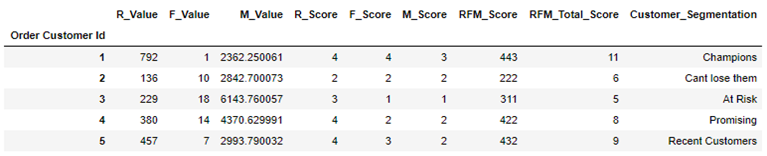
RFM Customer Segmentation
Understanding customer needs and targeting specific clusters of customers based on their need is one way for a supply chain company to increase number of customers and also to gain more profits.
R_Value (Recency) indicates how much time elapsed since a customer last order.
F_Value (Frequency) indicates how many times a customer ordered.
M_Value (Monetary value) tells us how much a customer has spent purchasing items.

Slide 15
RFM Customer Segmentation
There are 33 different customer segments. To make it easier for segmentation individual R,F,M scores are added together.
There are 9 values in total for customer segmentation. Appropriate names were assigned for each value separately.
Since total customers are divided into 9 segments it can be seen that, 11.4% customers are at risk of losing them as customers and 11% customers needs attention else even they will be lost eventually. It can be seen that 4.4% of customers are already lost.
Our Top 10 Churned best customers who has not purchased anything in a while are presented in the next slide. These customers used to place orders with huge amounts very frequently but they did not place orders from almost a year which means they are purchasing from other companies. These groups of people should be targeted with offers to gain them back.
Using the RFM Analysis, Top 10 new best customers who place costly orders often can be found out.
These customers has the potential to become best customers this people should be targeted to convert them into loyal customers. All these different segment of customers should be targeted with different tailored advertisements and rewards for increased profits and more responsiveness from customers.

Slide 16
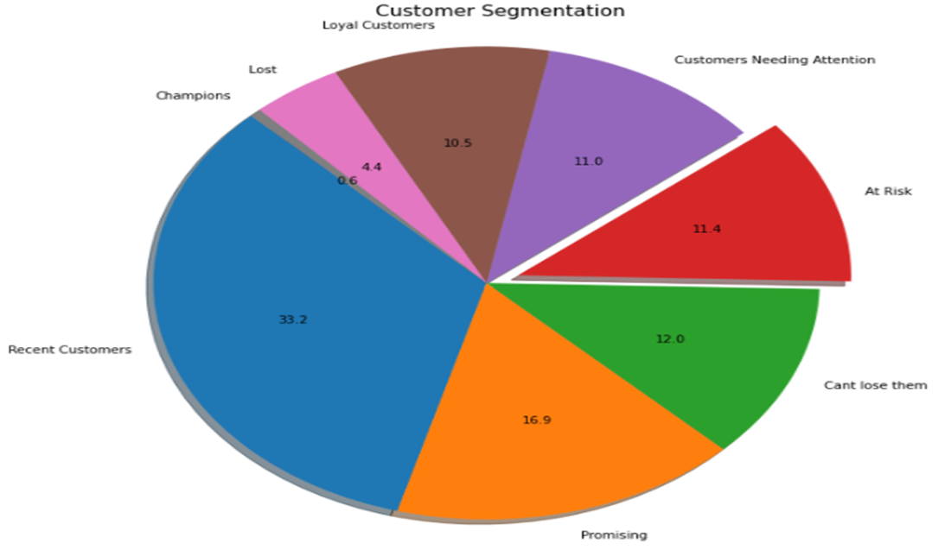
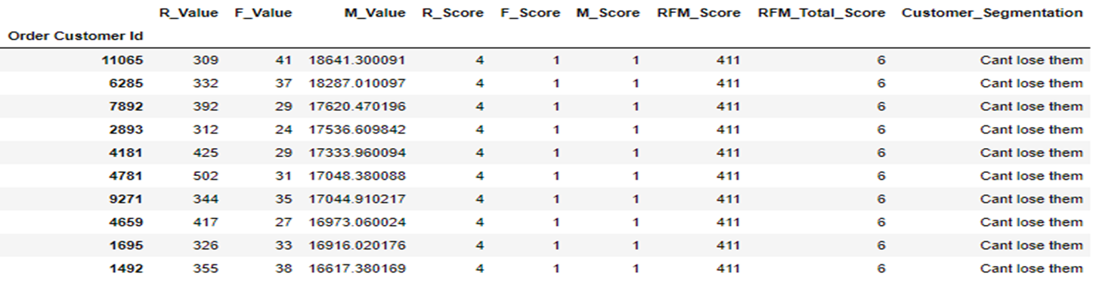
RFM Customer Segmentation

Slide 17

THANK YOU

